Slide 1
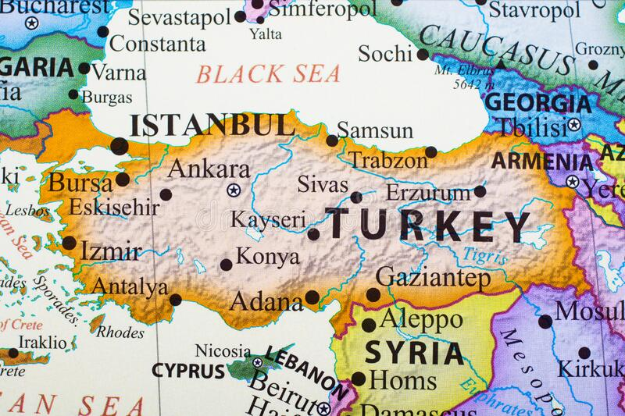
Capital Markets Report
Cumali Bereket –s211060 /BDA 2022

Slide 2

Content
General Informatıon
Insurance Sector
Banking Sector
Capital Markets
Treasury Bond

Slide 3
General Informatıon (Population, Main cities,GDP,Currency and Recent exchange rates)
Population
Turkey, offically the Republic of Türkiye, is a transcontinental country located mainly on the Anatolian Peninsula in Western Asia, with a small portion on the Balkan Peninsula in Southeast Europe. It shares borders with the Black Sea to the north; Georgia to the northeast; Armenia, Azerbaijan, and Iran to the east; Iraq to the southeast; Syria and the Mediterranean Sea to the south; the Aegean Sea to the west; and Greece and Bulgaria to the northwest. Cyprus is located off the south coast. Turks form the vast majority of the nation's population and Kurds are the largest minority. Ankara is Turkey's capital, while Istanbul is its largest city and financial centre.
In 2021, population for Turkey was 85 million persons. Population of Turkey increased from 36.6 million persons in 1972 to 85 million persons in 2021 growing at an average annual rate of 1.74%. The description is composed by our digital data assistant.
According to the latest available figures from the Turkish Directorate General of Migration Management (DGMM), there are more than 5* million foreign nationals present in Turkish territory, 3.7* million of whom are seeking international protection.

Slide 4
Main Cities
This is a list of cities and towns in Turkey by population, which includes cities and towns that are provincial capitals or have a population of at least 7,000. The total population of Turkey is 84,680,273 according to the 2020 estimate, making it the 17th most populated country in the world.
Istanbul, Turkey's economic and cultural capital is the largest city with a population of 15.84 million.
Ankara, the capital of Turkey has a population of 5.7 million.
Izmir, Turkey's third largest city has a population of over 4.3 million as of 2019.
Bursa, Turkey's fourth largest city has a population of over 3.1 million in its metropolitan area.
Antalya, Turkey's fifth-largest city has a population of 2.5 million in its metropolitan area as of 2019.

Slide 5
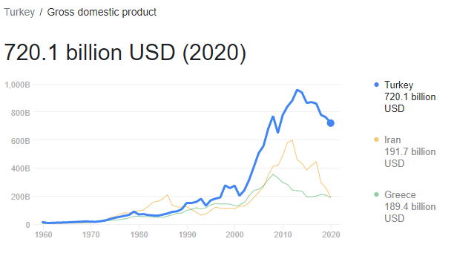
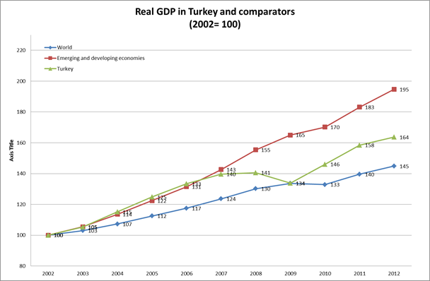
GDP - Value and GDP Annual Growth

Slide 6
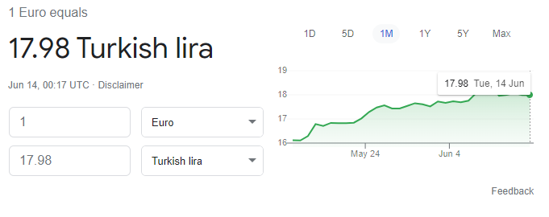
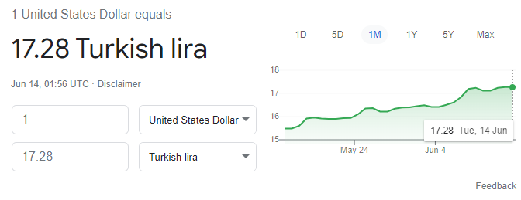
Recent Exchange Rates

Slide 7
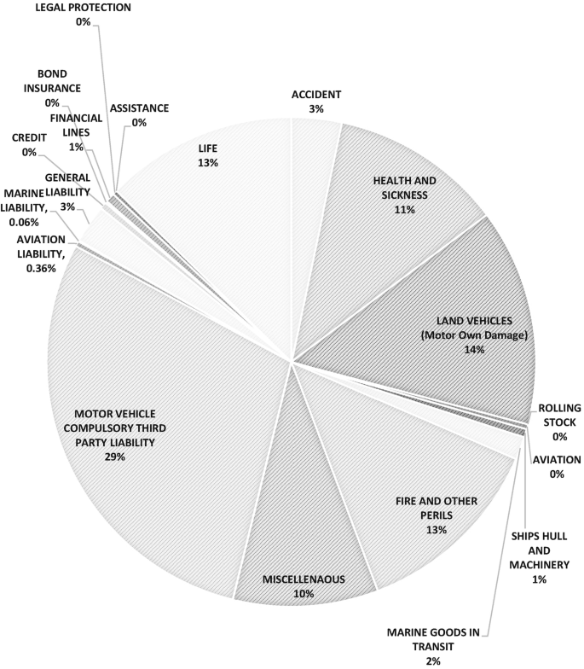
Insurance Sector
Competitive Profile The Turkish insurance sector is highly competitive, and foreign-owned companies hold an around 50% market share in life and non-life combined. The price cap on MTPL business bolstered competition in MTPL to a level that Fitch considers detrimental to market fundamentals.

Slide 8
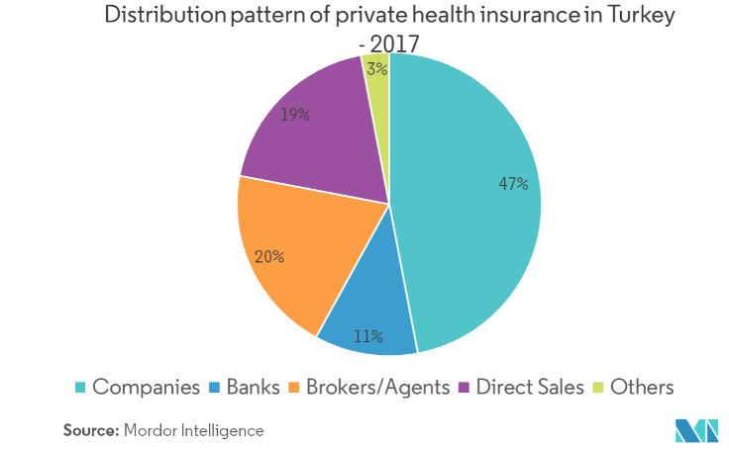
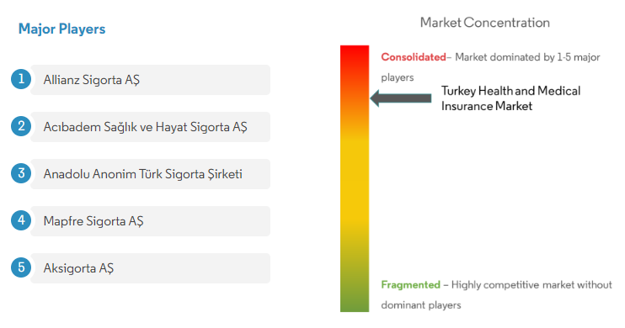

Slide 9
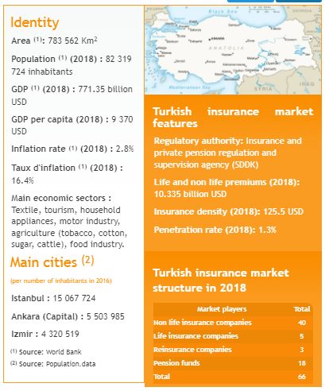
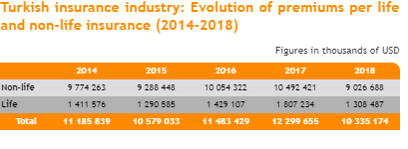
Turkish insurance industry in 2018: ranking of companies and turnover per class of business

Slide 10
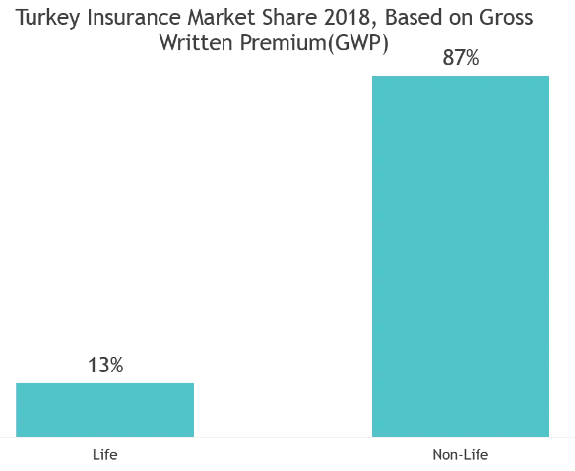
Value of Gross Written Premium in Turkey

Slide 11
Banking Sector
Number of banks operating in the banking sector was 53 as of December 2020. Of these 34 of them were deposit banks, and 13 were development and investment banks. Of the deposit banks, three were state-owned banks, and eight were private banks. There were six participation banks in Turkey.
According to temporary data reported by banks to our Agency, as of April 2022 total assets of Turkish Banking Sector realized as TRY 10.375. 369 million. Total assets of the banking sector increased by TRY 1.159. 906 million (12.6%) compared to 2021 year-end.
Banking in Turkey is an important aspect of the financial system Turkey's dynamic economy. Banks handle the majority of money and capital market transactions and activity. Commercial banks make up the majority of Turkey's financial sector, accounting for 91 percent of overall financial sector assets as of 2020.

Slide 12

Top Banks in Tukey
Ziraat Bank
Türkiye İs Bankası
Garanti Bank
AKBank.
Yapi Kredi Bank
Denizbank
Finansbank
Vakifbank
Halkbank
Turkish Bank
İlbank
Fibabanka
QNB Finansbank
Anadolubank
Turkish Eximbank
ING Bank Turkey
HSBC Bank Turkey
Şekerbank
Alternatif Bank
Türk Ekonomi Bankası

Slide 13
Commercial Banks in Turkey
Ziraat Bank. Established in 1863 with headquarters in Ankara, this is the largest bank in Turkey in terms of assets.
Isbank. Established in 1924, this has been the first public bank established by the Turkish Republic.
Garanti Bank.
AKBank.
Yapi Kredi Bank.
Denizbank.
Finansbank.
Vakifbank.

Slide 14
Coperatıve Banks in Turkey
Şeker Bank
İlbank
Anadolu Bank
Halk Bank

Slide 15
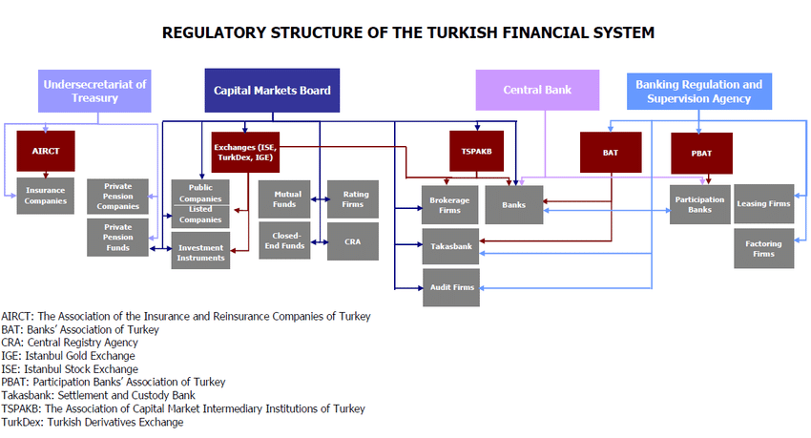
Regulatory Structure of the Turkish Financial System

Slide 16
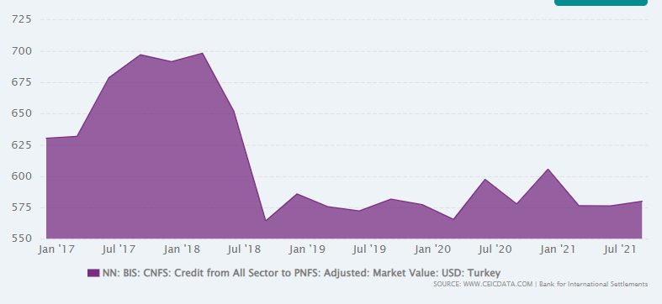
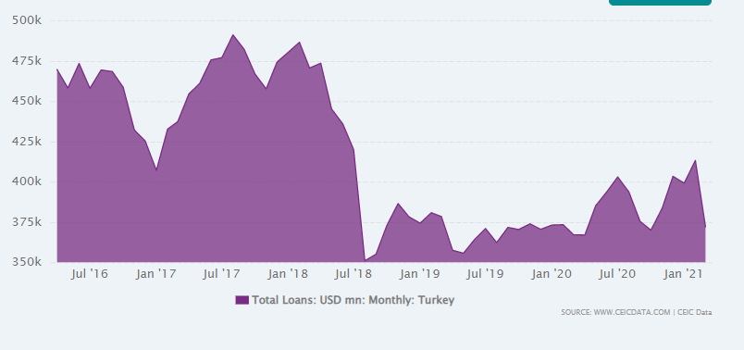
Structure of the lending activities – loans to nonfinancial sector
The share of loans to households in the total loans to the non financial sector
The share of loans to enterprises in the total loans to the nonfinancial sector

Slide 17
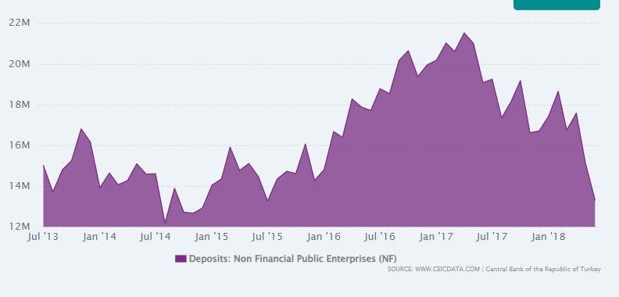
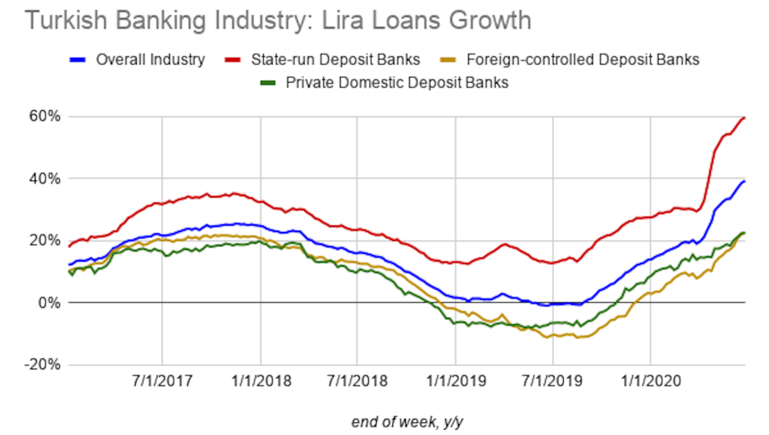
The average interest rates
Loans
Deposits from non financial sector

Slide 18
The Biggest Banks in Turkey
1. Ziraat Bank
Established in 1863 with headquarters in Ankara, this is the largest bank in Turkey in terms of assets. It provides various banking products and services to retail, small and medium businesses, and corporate customers within the borders of Turkey and even outside. Interestingly, the bank was founded in Serbia which was then part of the Ottoman Empire. However, now, it has 1,864 branches with over 24,000 employees and has a presence in 18 different countries other than Turkey and its focus has mainly been on real estate and meeting the banking needs of individuals. As of the end of 2018, its assets totaled $91.60 billion while its net profit stood at $1.69 billion.
2. Isbank
Established in 1924, this has been the first public bank established by the Turkish Republic. The bank offers corporate and commercial banking services to large corporations, SME’s and other small and big trading companies. İşbank was even ranked 96th in a survey of “The World’s Biggest 1000 Banks. The bank has 1,351 branches in Turkey and 23 branches in other countries with 55,000 employees. As of the end of 2018, the total assets of the bank stood at $79.8 billion and a net profit of $1.21 billion.
3. Garanti Bank
The bank has approximately 22,000 employees serving approximately 14 million customers. At the end of 2018, the bank reported a total of $80 billion in assets and $1.301 billion.
4.Vakifbank
Total assets of the bank are valued at ₺419.4 billion, generating ₺17.0 billion revenue and ₺3.6 billion operating income via a 2019 report, employing 16,835 workers.

Slide 19
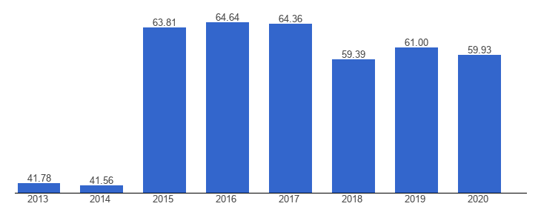
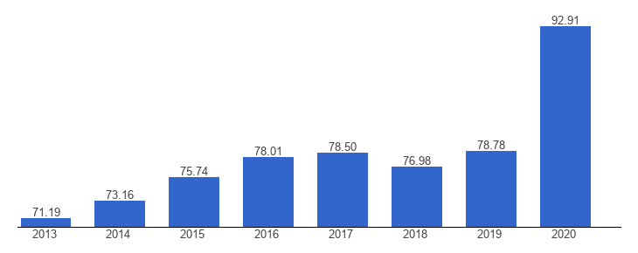
Banking sector
Concentration of the banking sector
Value of Assets

Slide 20
Capital Markets ın Turkey
Borsa Istanbul (BIST)
The Borsa İstanbul (abbreviated as BIST) is the sole exchange entity of Turkey combining the former Istanbul Stock Exchange (ISE) (Turkish: İstanbul Menkul Kıymetler Borsası, IMKB), the Istanbul Gold Exchange (Turkish: İstanbul Altın Borsası, İAB) and the Derivatives Exchange of Turkey (Turkish: Vadeli İşlem Opsiyon Borsası, VOB) under one umbrella. It was established as an incorporated company with a founding capital of ₺ 423,234,000 (approx. US$240 million) on April 3, 2013, and began to operate on April 5, 2013. Its logo is the traditional Ottoman mark for Istanbul, the tulip. Its slogan is worth investing.
Shareholders of Borsa İstanbul are: 49% Government of Turkey, 41% IMKB, 5% VOB, 4% IMKB members, 1% IMKB brokers and 0.3% IAB members. It is planned that all the Government-owned shares will be offered for sale. Among the executives of the nine-member board of directors, which is presided by chairman Himmet Karadağ, are former deputy chairman of ISE Osman Akyüz, former head of VOB Işınsu Kestelli, Merrill Lync Investment Bank General Manager Hüseyin Kelezoğlu and Chairman of Turkish Association of Capital Market Intermediary Institutions Attila Köksal.

Slide 21
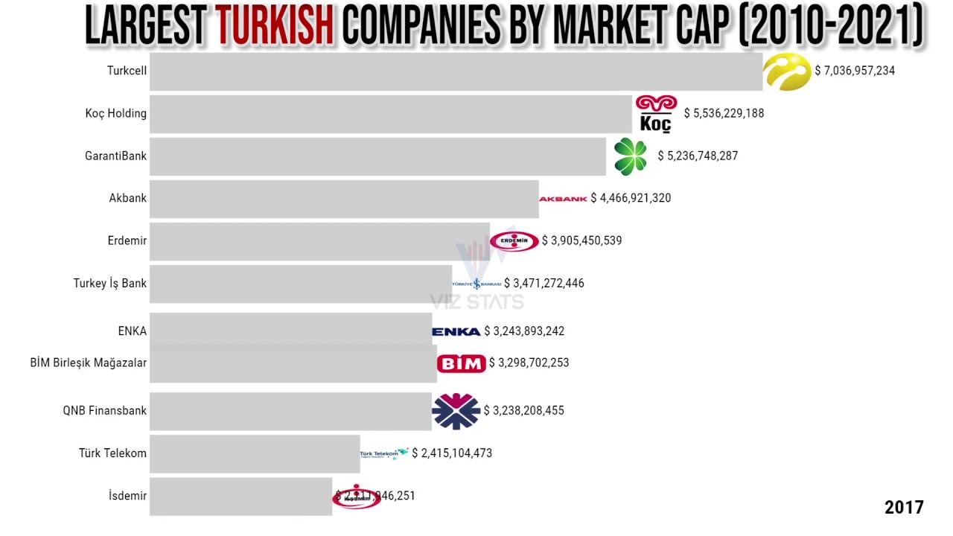
Top Corporations in Turkey

Slide 22
Perspectives of the stock market in Turkey
Turkey is a perfect country for Investment due to a young, dynamic and skilled workforce in a country of almost 80 Million people. Besides that the Governmental Incentives, Tax Exempts and Free land allocations are making Turkey even more appealing to Investors.
The 5 most ideal sectors to Invest in Turkey
1) IT and Technology
2) Construction and Real Estate
3) Textile and Ready to Wear Clothing
4) Energy and Natural Resources
5) Environment and Recycling

Slide 23
Treasury bond market in Turkey
Value of the country’s public debt
In 2021 Turkey public debt was 284,046 million euros335,999 million dollars, has increased 51,502 million since 2020. This amount means that the debt in 2021 reached 41.65% of Turkey GDP, a 2.13 percentage point rise from 2020, when it was 39.52% of GDP.
Value of the country’s budget deficit
Turkey's central government budget swung to a deficit after running a surplus for two consecutive months as spending outpaced tax collection. The government posted a monthly fiscal deficit of 69 billion liras ($4.7 billion) in March, compared with a gap of 23.8 billion liras in the same month a year earlier

Slide 24
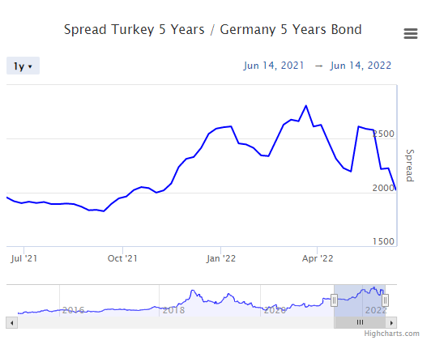
Turkey 5 Years vs Germany 5 Years Spread
The Turkey 5 Years / Germany 5 Years Government Bond spread value is 2024.9 bp
The Turkey 5 Years / Germany 5 Years Government Bond spread reached a maximum value of 2884.1 bp (24 March 2022) and a minimum value of 803.1 bp (2 March 2015).

Slide 25
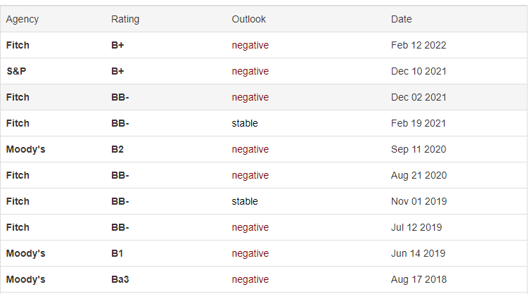
Rating of the Turkey
Standard & Poor's credit rating for Turkey stands at B+ with negative outlook. Moody's credit rating for Turkey was last set at B2 with negative outlook. Fitch's credit rating for Turkey was last reported at B+ with negative outlook. DBRS's credit rating for Turkey is BB (high) with negative outlook. In general, a credit rating is used by sovereign wealth funds, pension funds and other investors to gauge the credit worthiness of Turkey thus having a big impact on the country's borrowing costs. This page includes the government debt credit rating for Turkey as reported by major credit rating agencies

Slide 26
Value of Treasury bonds outstanding Turkey
The Turkey 10Y Government Bond has a 20.520% yield.
10 Years vs 2 Years bond spread is -373 bp. Yield Curve is inverted in Long-Term vs Short-Term Maturities.
Central Bank Rate is 14.00% (last modification in December 2021).
The Turkey credit rating is B+, according to Standard & Poor's agency.
Current 5-Years Credit Default Swap quotation is 798.94 and implied probability of default is 13.32%.

Slide 27
Recent values of CDS for Treasury bonds in Turkey
The Turkey 5 Year CDS value is 798.94 . This value reveals a 13.32% implied probability of default, on a 40% recovery rate supposed. CDS value changed +11.56% during last week, +15.26% during last month, +117.09% during last year.

Slide 28
Thanks For Listening..

